Slide 1
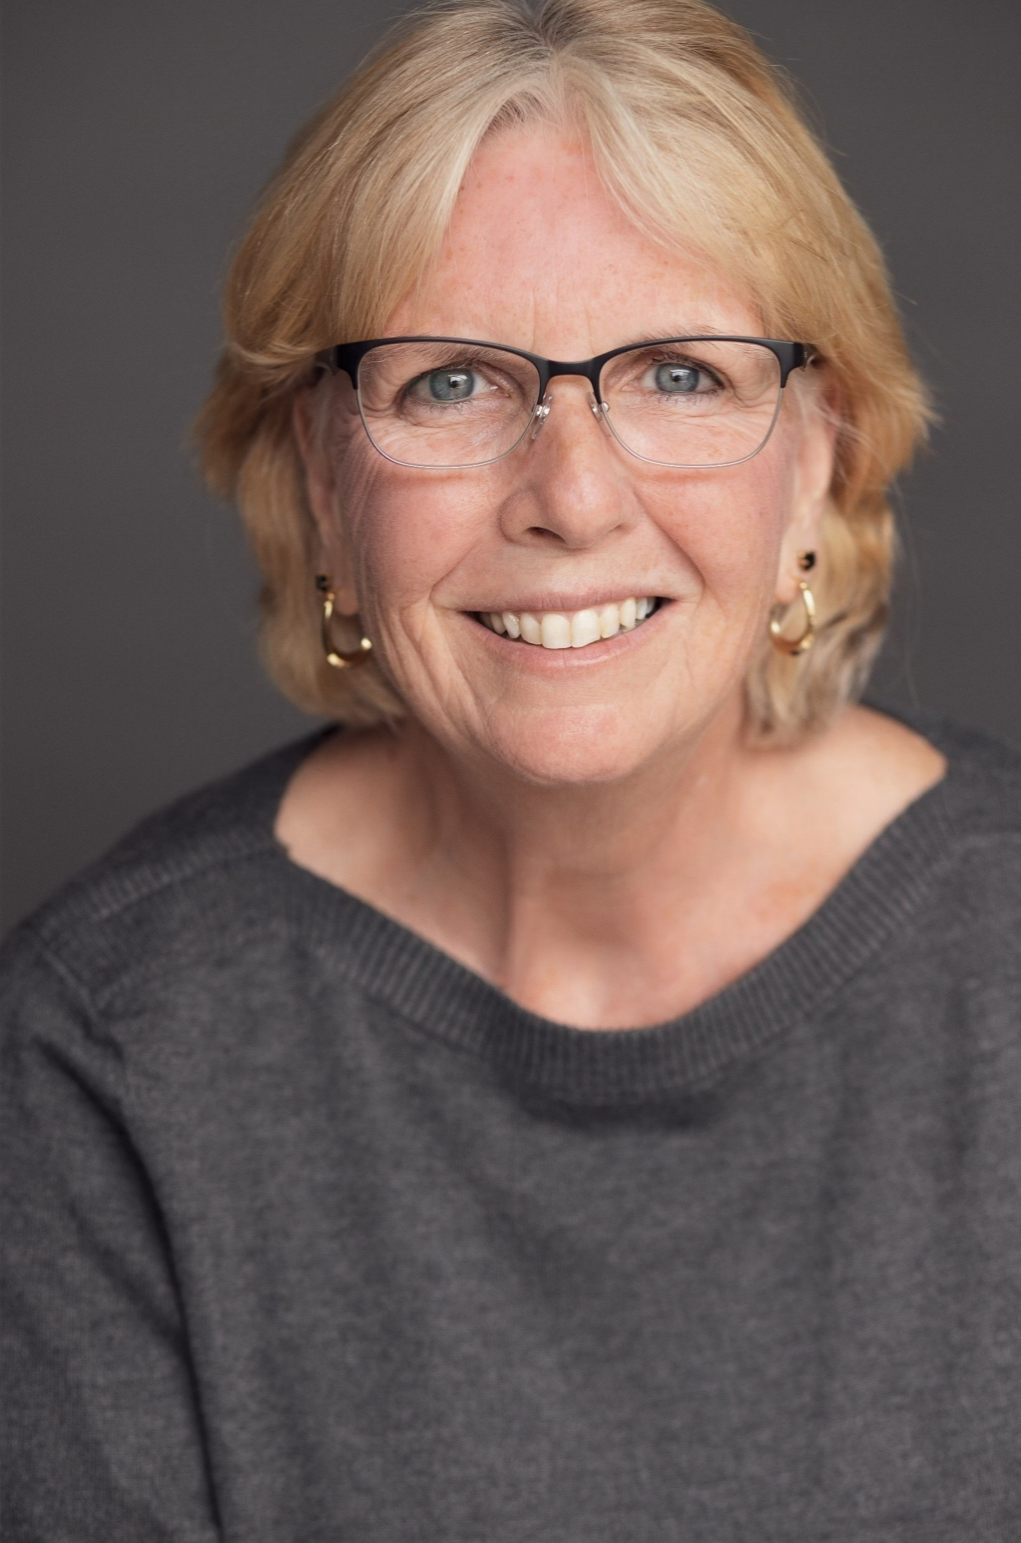
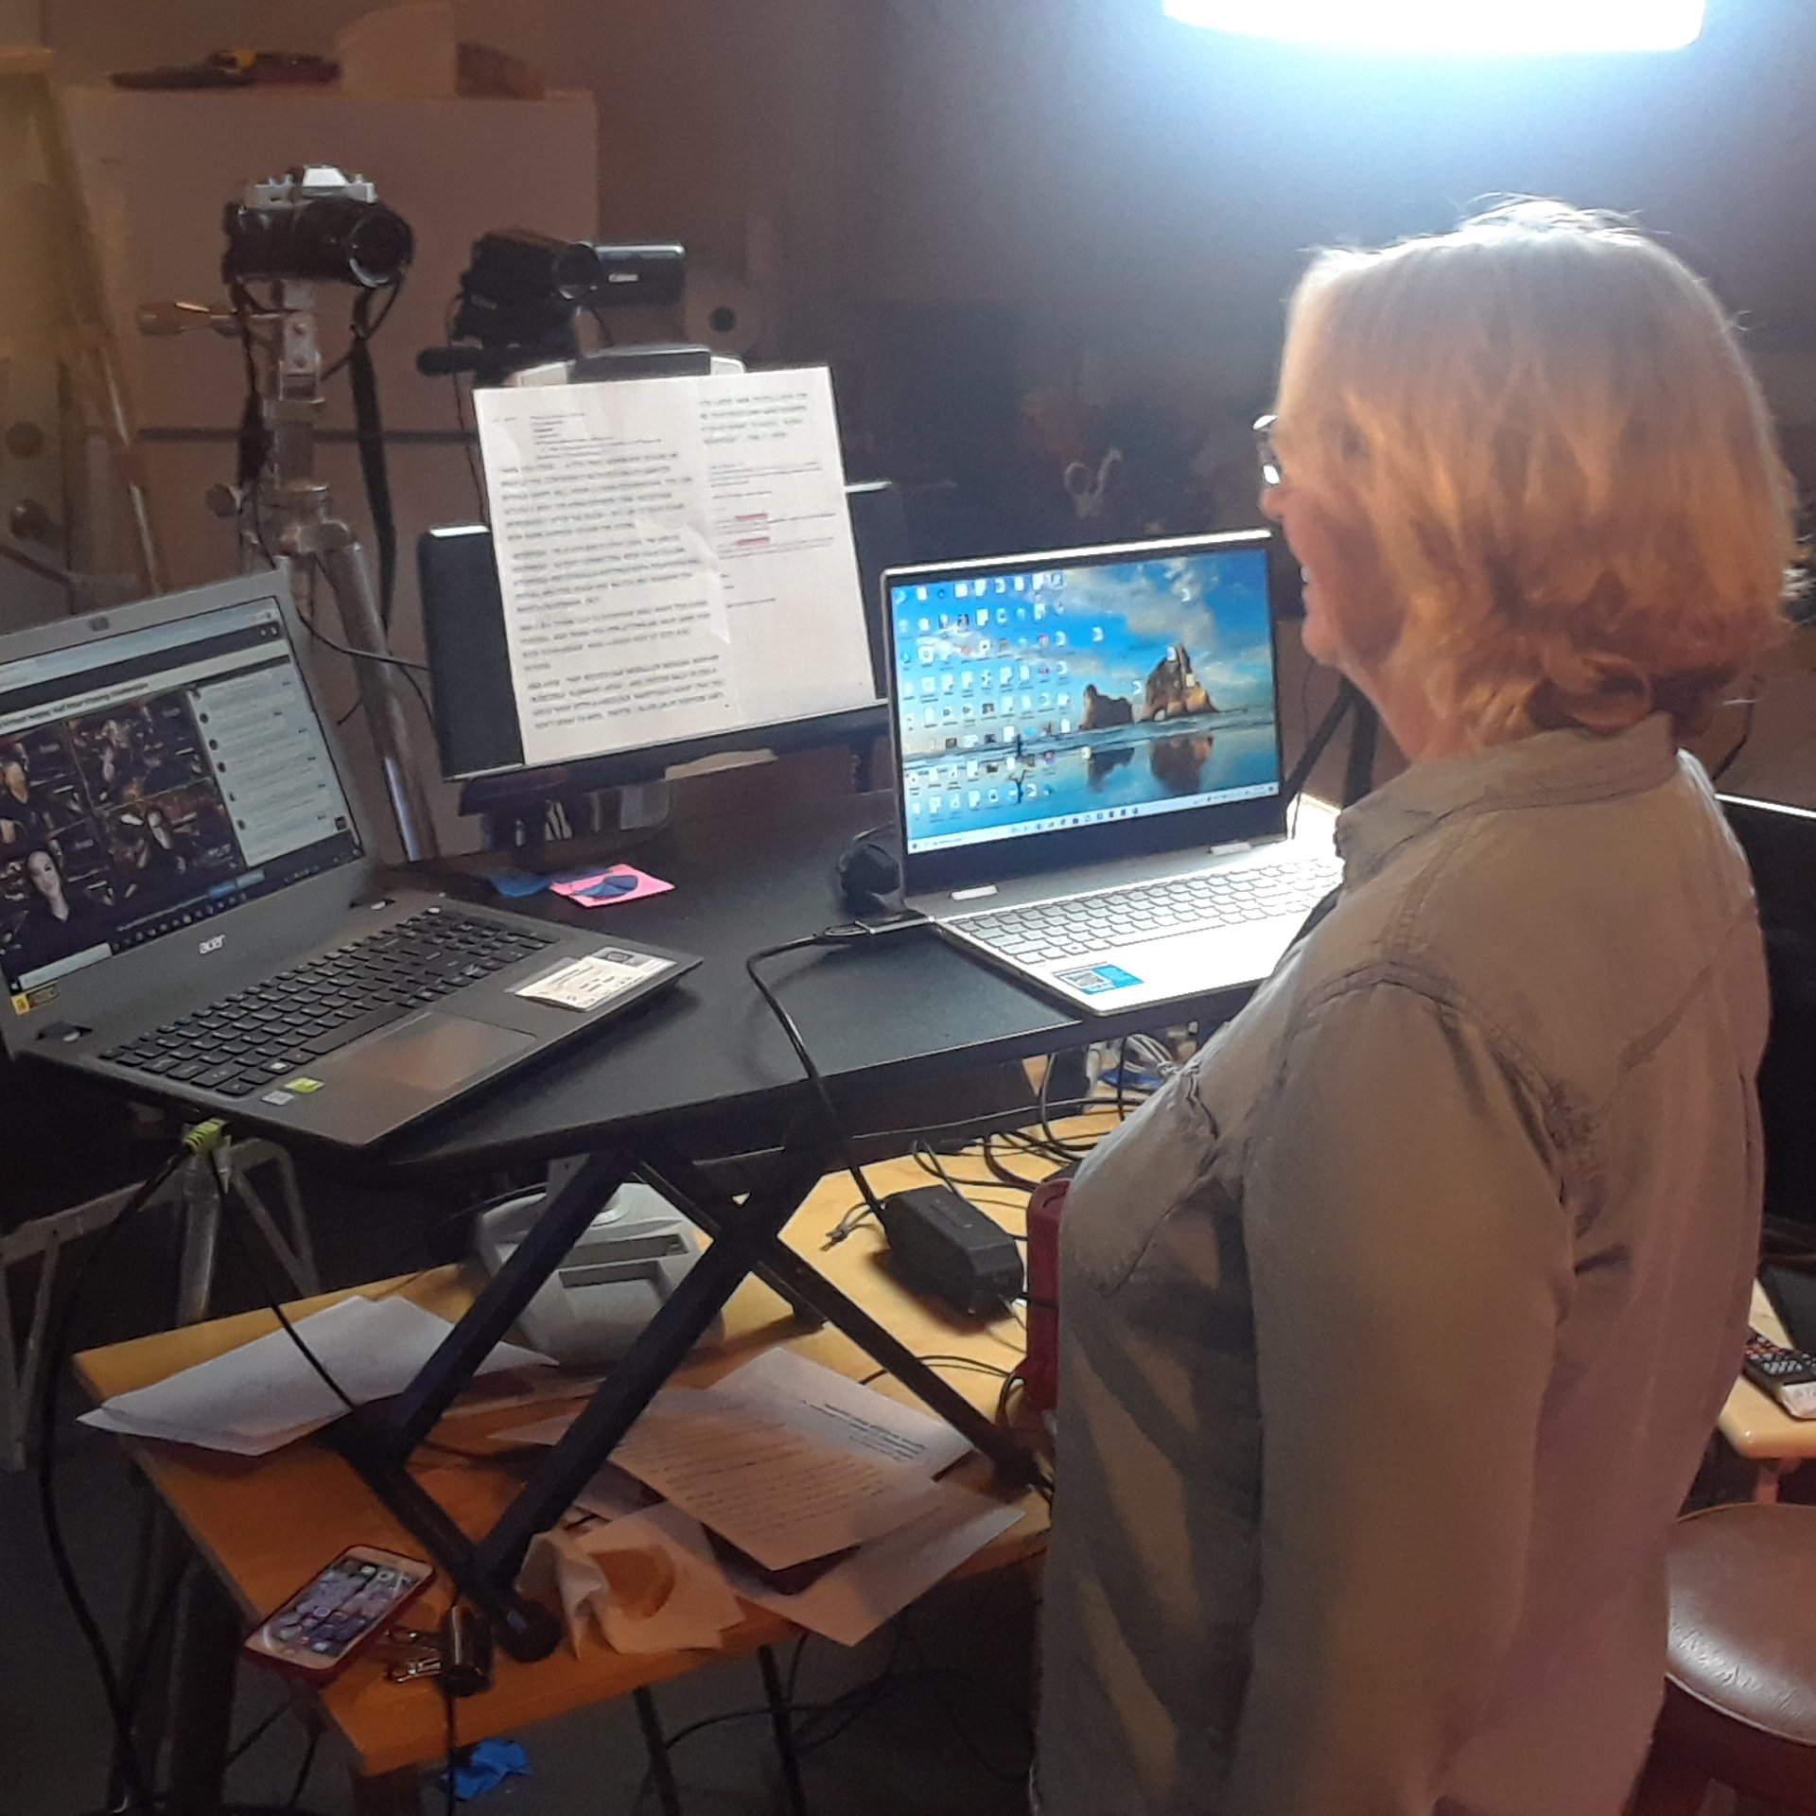
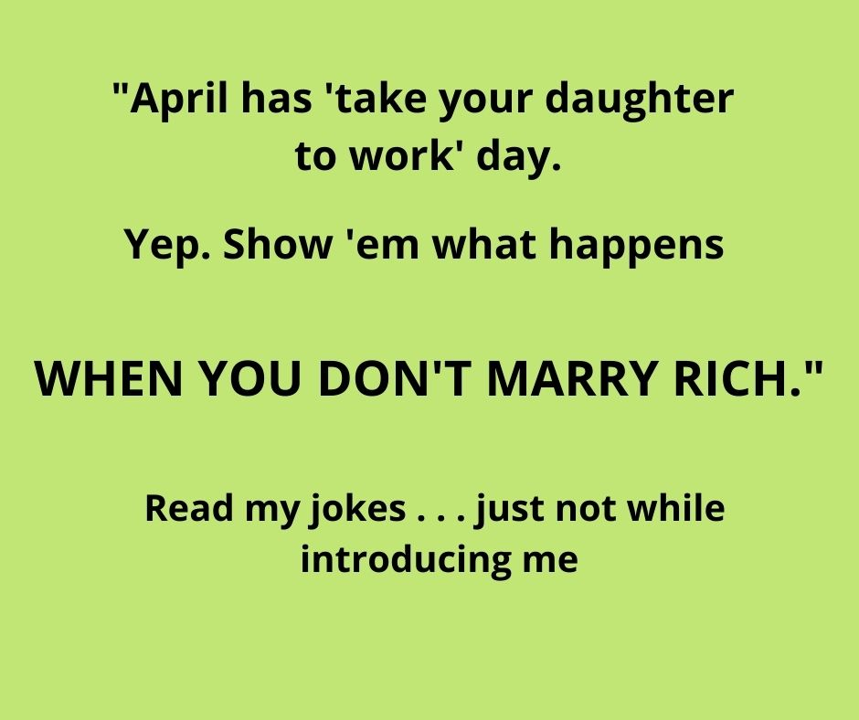
The Keynote Chronicle
Humor News from Jan McInnis
800-492-9394
www.TheWorkLady.com • Jan@TheWorkLady.com www.linkedin.com/in/janmcinnis
Weird Introductions!!
Spotlight
"And now coming to the stage, our entertainment for tonight – Jan McInnis, The Working Girl!" What do you think of when you hear THAT introduction? A comedian? A keynote speaker? Or perhaps some other "shadier" profession?
Pin this article up for others to enjoy!!!
Male sure You’re Using Jan For:
Finding the Funny in Change Keynote
Bouncing Back: Handling Setbacks with humor & Resiliency Keynote
Master of Ceremonies for your Banquet
Her Clean Comedy Show
Well I've had that introduction before, and
I've seen the looks on audience members’
faces that say, "What kind of entertainment
did we hire?" The emcee in this case
confused my keynote and humor website,
TheWorkLady.com, with the street walker
profession, which left the audience baffled.
Luckily I'm a comedian, so I was able to have
some fun with this introduction. And by the
way, I have that website because the spelling
of my last name is hard to remember and I do a lot of work humor. My site has been around forever, so it's kinda hard to change now.
TWO WAYS TO HEAR ME OR ALEX:
Download the free QR code app to scan this code for a clip of Finding the Funny in Change.
Jan is Master of Ceremonies for two multi-day virtual events, in 3 time zones at once! Attendee:
“You were perfect to start the day with an upbeat message Thank you again.”
But sadly, that's not the worst introduction I've ever gotten. Here are a few other memorable/funny introductions:
The Joke Reader: Yep, I've stood backstage on more than one occasion while someone actually read some of my jokes. . . you know, the ones I was about to tell onstage. One woman was getting a lot of laughs with them, and really enjoyed the spotlight. I think she said a half-dozen or so before bringing me out. And another guy said to the group, "I’m sorry, but this is so funny, I have to just say it." He got laughs too, but I was backstage thinking, “No you don't have to say it, because I will!”
The Long Bio: At least reading my jokes gets the crowd laughing so it isn't deadly, but reading my two-page bio IS. And yes, it's happened. My bio lists lots of accomplishments that my mom likes to hear about. . . the audience, not so much.
The Confusing Intro: One person read the email that I sent to get hired for the event. How that
ever got into their hands is beyond me. She read all the great things about me and why I should
get hired, blah, blah, blah. I'm sure the audience was thinking, "Are we voting to hire her? She’s standing right there!" I'm thinking, “ya know, I flew in for this gig. I'm going on stage.” It was odd.
The Angry Intro: Humor and yelling don’t mix, but I've had it happen. One guy who was having trouble getting the group quiet and focused, grabbed the mic and screamed, "Okay, everyone!
Shut the hell up and listen. We have a comedian coming up, and she's really funny!" Dead
silence. Great, now there's pressure on me to be funny AND more entertaining than
whatever these people were talking about with their friends. It's really hard to follow
"Shut the hell up and listen." That line should be banned from introductions.
The Quiet Intro: On the other end of the spectrum is the person who is so quiet, you can't hear
them. They're usually holding the mic down around their waist, and don't bother to get the
crowd focused and settled. They hate doing the intro, so they read it quickly and bring me out
to a chatty crowd who has no idea who I am.

Slide 2
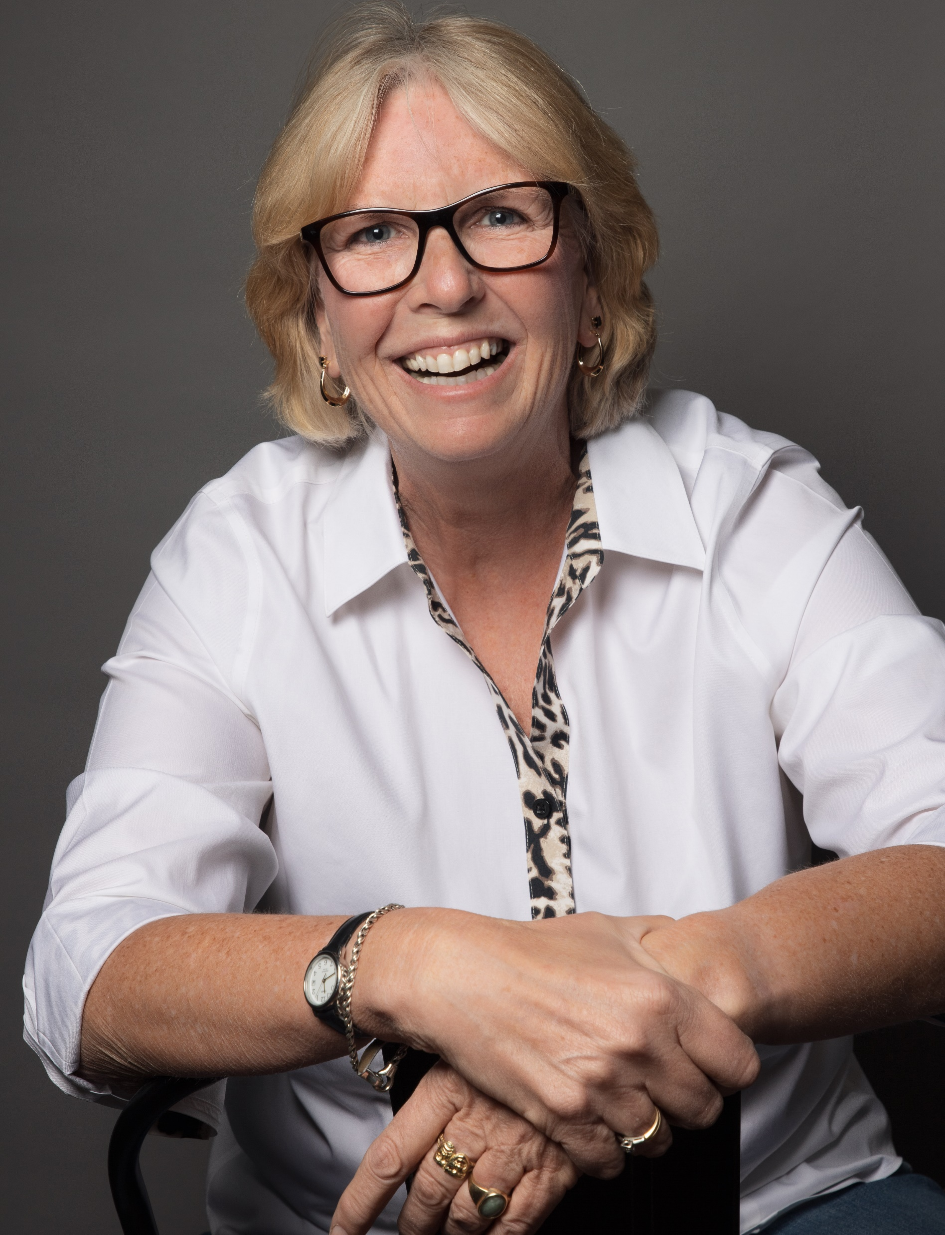
The Wannabe Comedian: I love it when people want to have fun with the introduction, as long as it's appropriate. Trying to be funny by saying, "We have a comedian. She better be funny or we're not paying her" is not funny. Luckily I had a great show, and at the end I looked at her and said, “Am I getting paid?”
The Wing-It Intro: Unless you are best friends with the person,
you should always read their introduction, otherwise you’ll
screw it up. Like the guy who remembered that I had written comedy for some big things, but he forgot that it was The
Tonight Show monologue. So instead, he got nervous and
blurted out, "Now coming to the stage is a writer for Reader’s
Digest." I'm sure the audience was thinking, "Can’t anyone do
that? You just have to send ‘em an article." It was an awkward
start for sure! And for the record, I've written for TV, radio, syndicated cartoon strips, and even guests on the Jerry
Springer Show (my parents are proud), but I have never
written for Reader's Digest.
Whether it’s virtual or in-person, humor helps!
Aside from The Angry Intro, none of these introductions were so bad I couldn't recover from them, but they did get things off on a weird start for sure. Here's hoping 2021 brings us together to make many more introductions, and may all of them be so good that you never have to explain to your friends and family that you are not a "working girl."
Jan has shared her customized humor keynotes with thousands of associations and corporations, and she is the author of 2 books: “Finding the Funny Fast” and “Convention Comedian.” She was also featured in the Wall Street Journal, the Washington Post, and the Huffington Post. . .
Recent Client Quotes:
“Though Jan is a comedian, she took her role as keynote and emcee very seriously!
She was a pleasure to work with, and as our post event survey comments revealed, she made a
virtual event fun and lively.”
“Thanks for presenting for our group! It definitely set a good vibe for the day and we’ve
referenced some of your talking points through the day when relatable things occurred.
You did a great job! “
About Jan . . .
Jan McInnis has written for Jay Leno’s Tonight Show monologue as well as many other people, places, and groups – radio, TV, syndicated cartoon strips, and even guests on the Jerry Springer show (her parents are proud). For 26+ years she’s traveled the country as a keynote speaker and comedian sharing her unique and practical tips on what business leaders can learn from comedians (no, it's not all about telling jokes). Jan can be reached at www.TheWorkLady.com, or Jan@TheWorkLady.com. And check out her podcast: Comedian Stories: Tales From the Road in Under 5 Minutes.
Connect with Jan on Linkedin: www.linkedin.com/in/JanMcInnis
This newsletter comes out 3 times a year...not as bad as spam in your inbox, but not as consistent as Reader’s Digest. A nice mix! If you know of someone who would like a copy, send ‘em to my website www.TheWorkLady.com to sign up.

